Slide 1

By: Karim Akmal & Omnia Elmenshawy
Credit Score Classification

Slide 2
Agenda
Intro to dataset
Dataset Problems
Data Pre-processing
Data Modeling
Model Deployment
Business Solutions

Slide 3
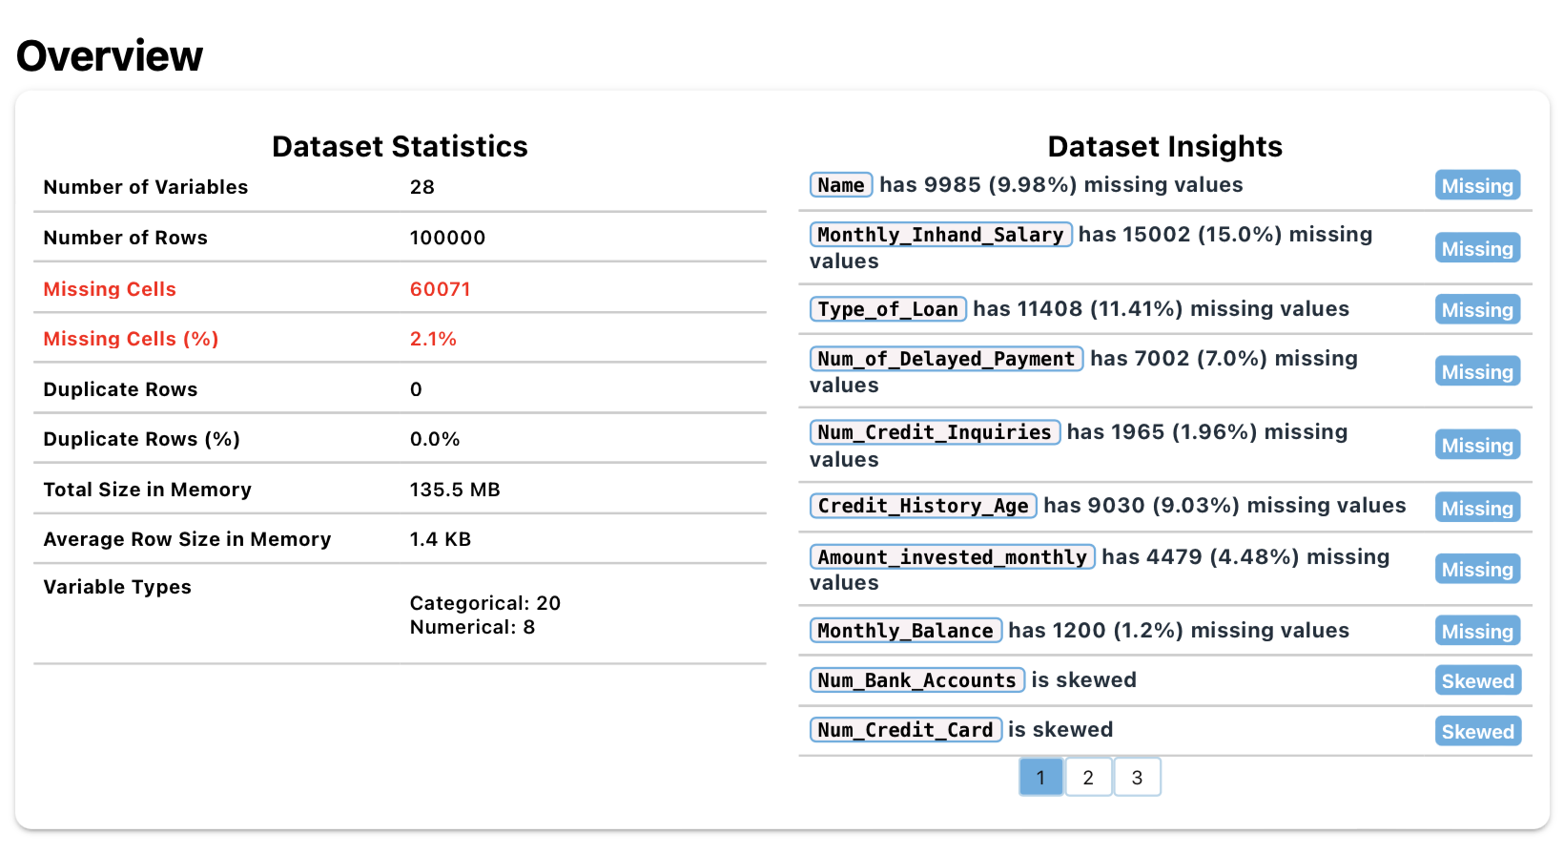
Intro to dataset

Slide 4
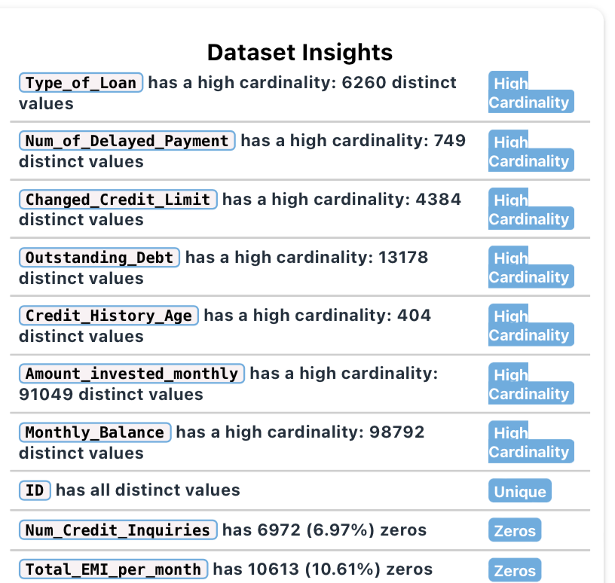
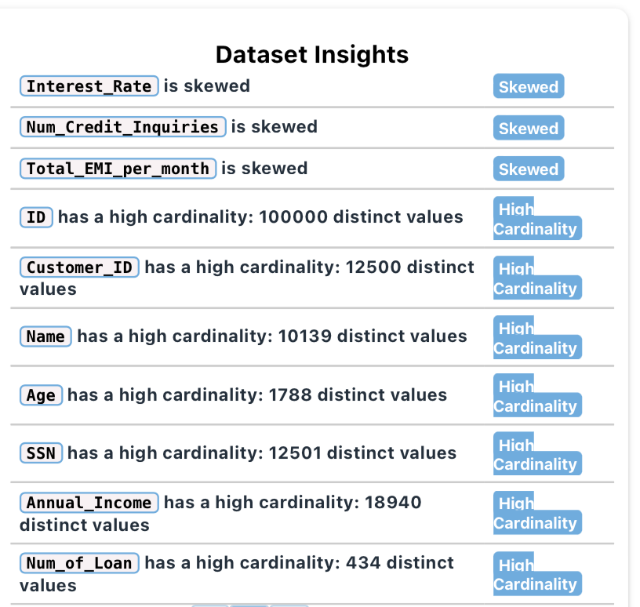

Slide 5
Dataset Problems
Some columns such as Age and number of bank account have negative values which could be considered as data noise.
Some columns has extreme values, such as the Age column, which has customers aging around 8600 years old.
Some columns are skewed.
Some columns has values that does not have meaning such as the “NM” value in the Payment_of_min_amount column.

Slide 6
Handling dataset problems column by column

Slide 7
ID, Name, and SSN columns
These are unnecessary columns which has no correlation with our dataset target, so they were dropped.

Slide 8
Type_Of_Loan
There were 8 different categories that needed to be splitted to handle the error caused by the entery team.
Then the whole column was dropped out and 8 different new columns were created.

Slide 9
Categorical Columns handled by Label Encoder
Customer_ID, Month
Occupation
Credit_Mix
Payment_of_min_amount
Credit_Score
Payment_Behaviour and columns

Slide 10
Numerical columns classified as Objects and handled by the reges function
Age
Annual_income
Num_of_loan
Num_of_delayed_payment
Changed_credit_limit
Outstanding_debtCredit_Mix
Payment_of_min_amount
Amount_invested_monthly
Monthly _Balance

Slide 11
Customer ID Column
Analysis
The column divides the dataset into 12500 customer, each Customer_ID maps and strongly relates to some other features.
Thus, The missing values of the dataset will be imputed relative to this column.

Slide 12
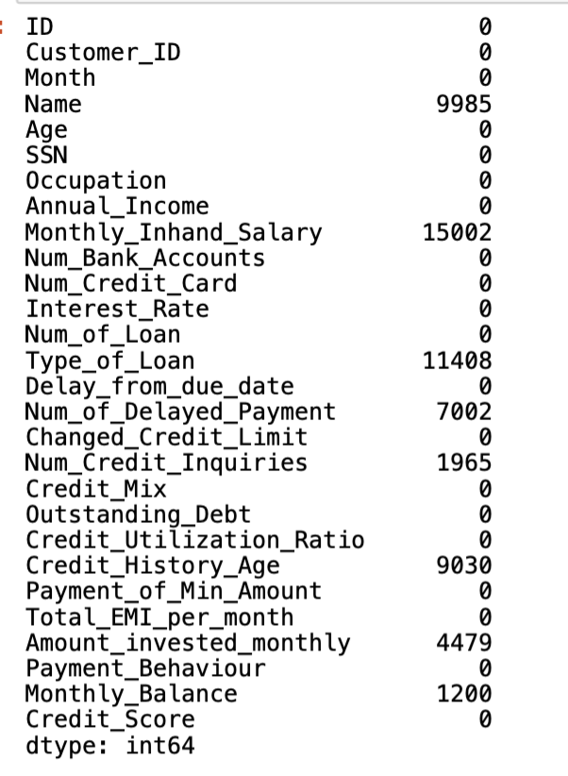
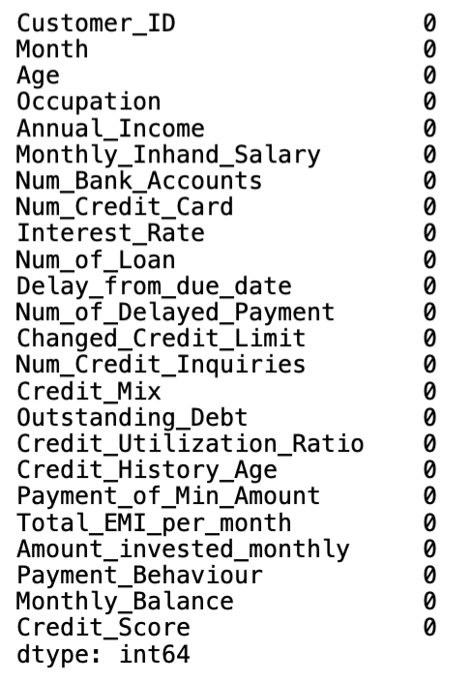
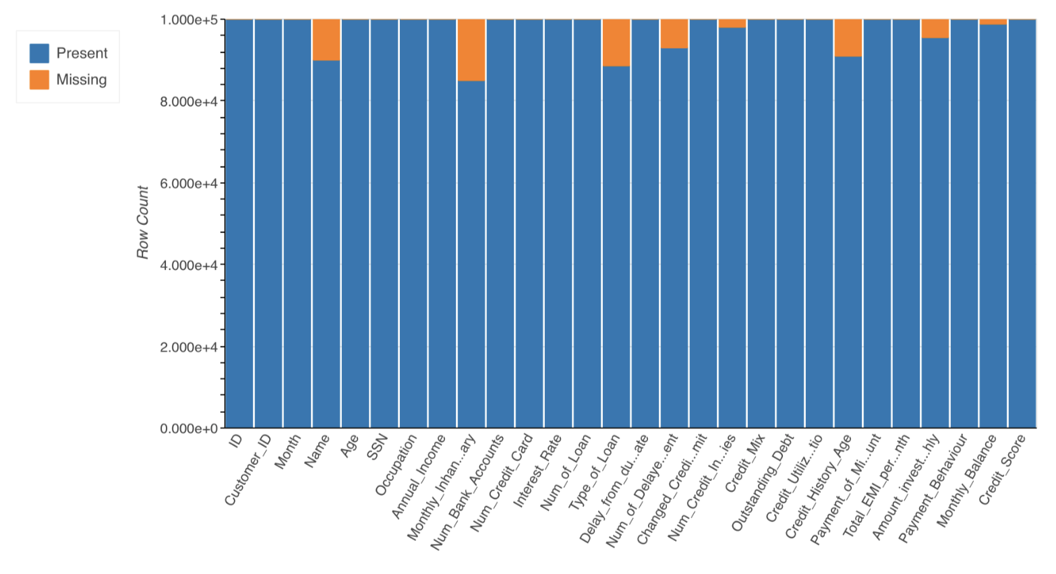
Missing Values
As every column in the dataset is related to the Customer ID column, we conclude that each customer has 8 rows in the dataset.
Thus, using KNN Imputer with 5 neighbors would give the best predictions for filling the missing values.

Slide 13
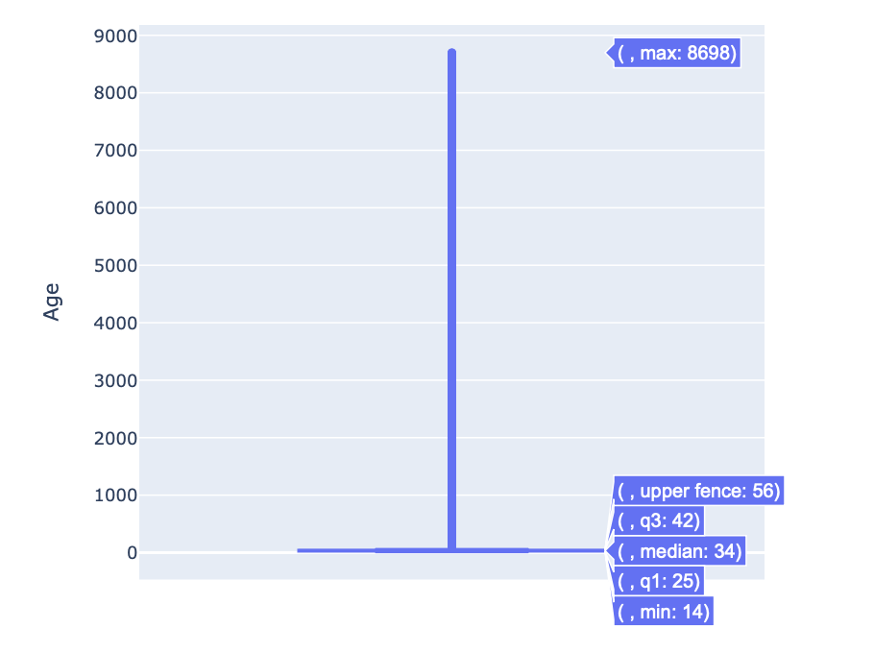
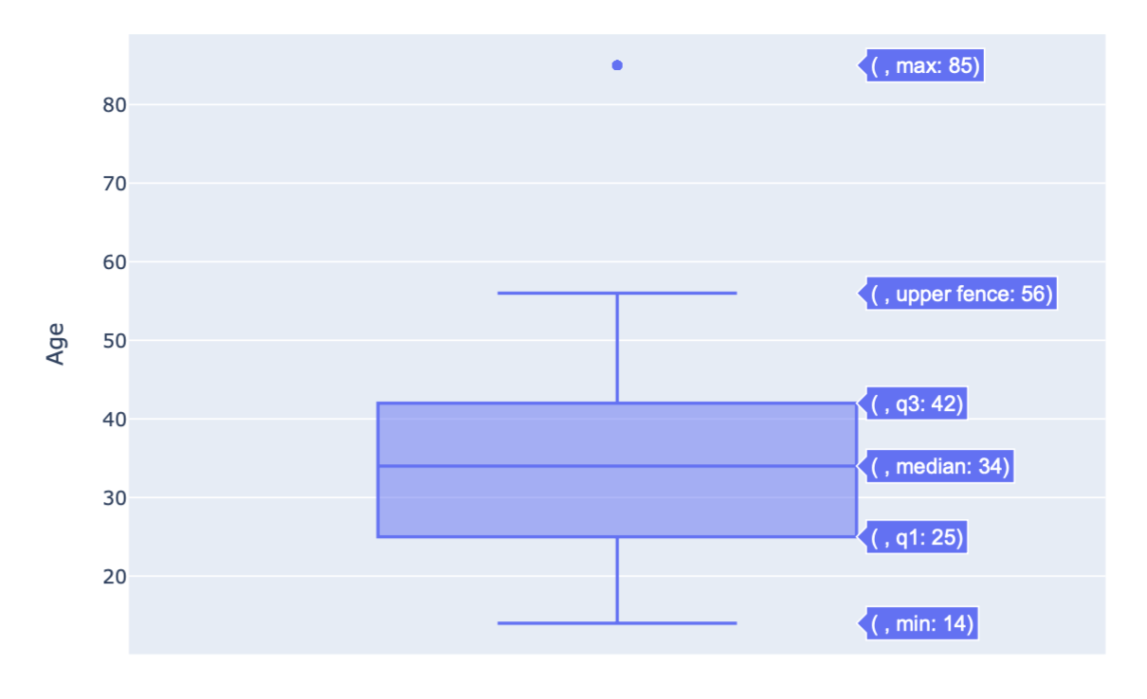
Outliers has been handled by the interquartile range method for each column
Example: Age column
Outliers
We have put a lower bound = 14 years old, and upper Bound of 85 years old and replaced the outliers
Age column has extreme values with max of 8698 years old.

Slide 14
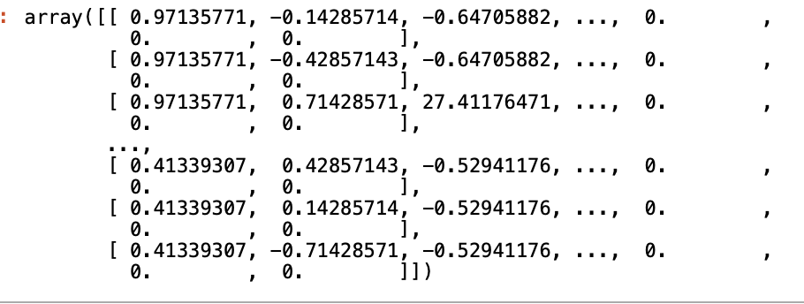
Robust Scaler
Balancing the Dataset
Done Manually on 3 Columns.
We used Robust Scaler to rescale the dataset.

Slide 15
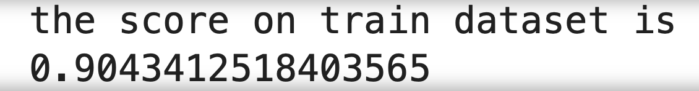
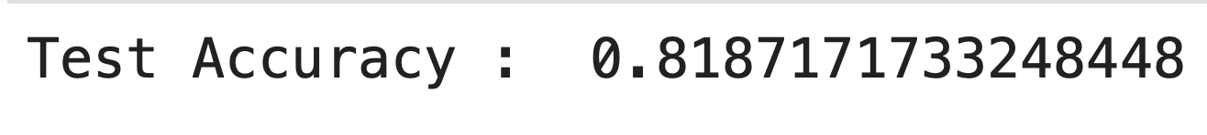
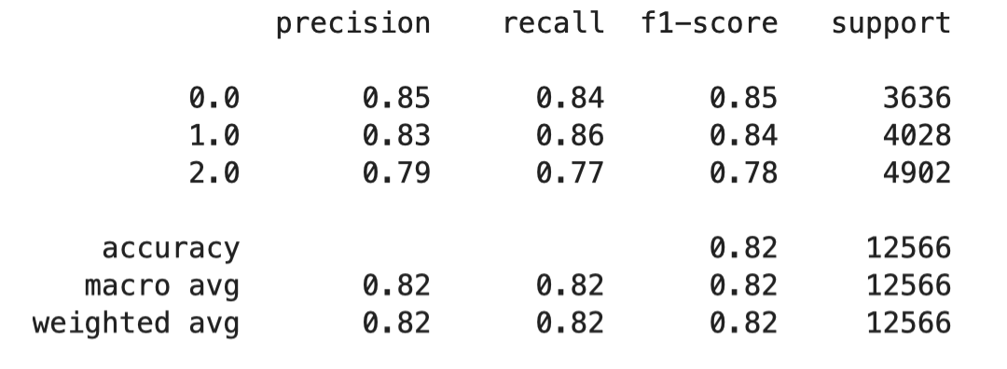
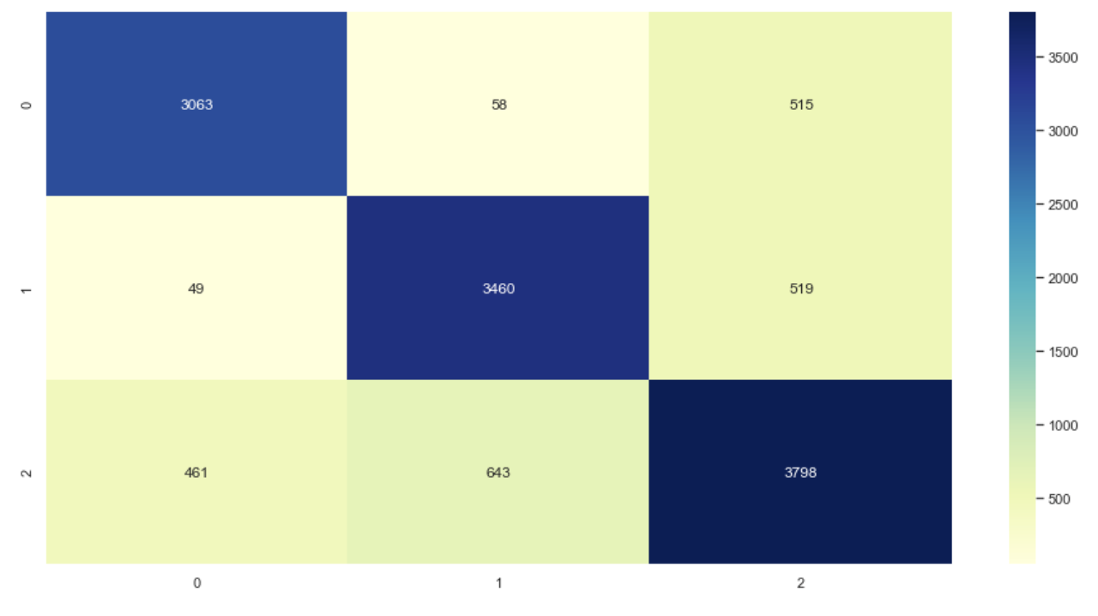
Modelling
Models Applied:
Best Model:
Logistic Classifier
KNN
GaussianNB
SVC
Random Forest
XGBOOST
ADABOOST
KNN

Slide 16
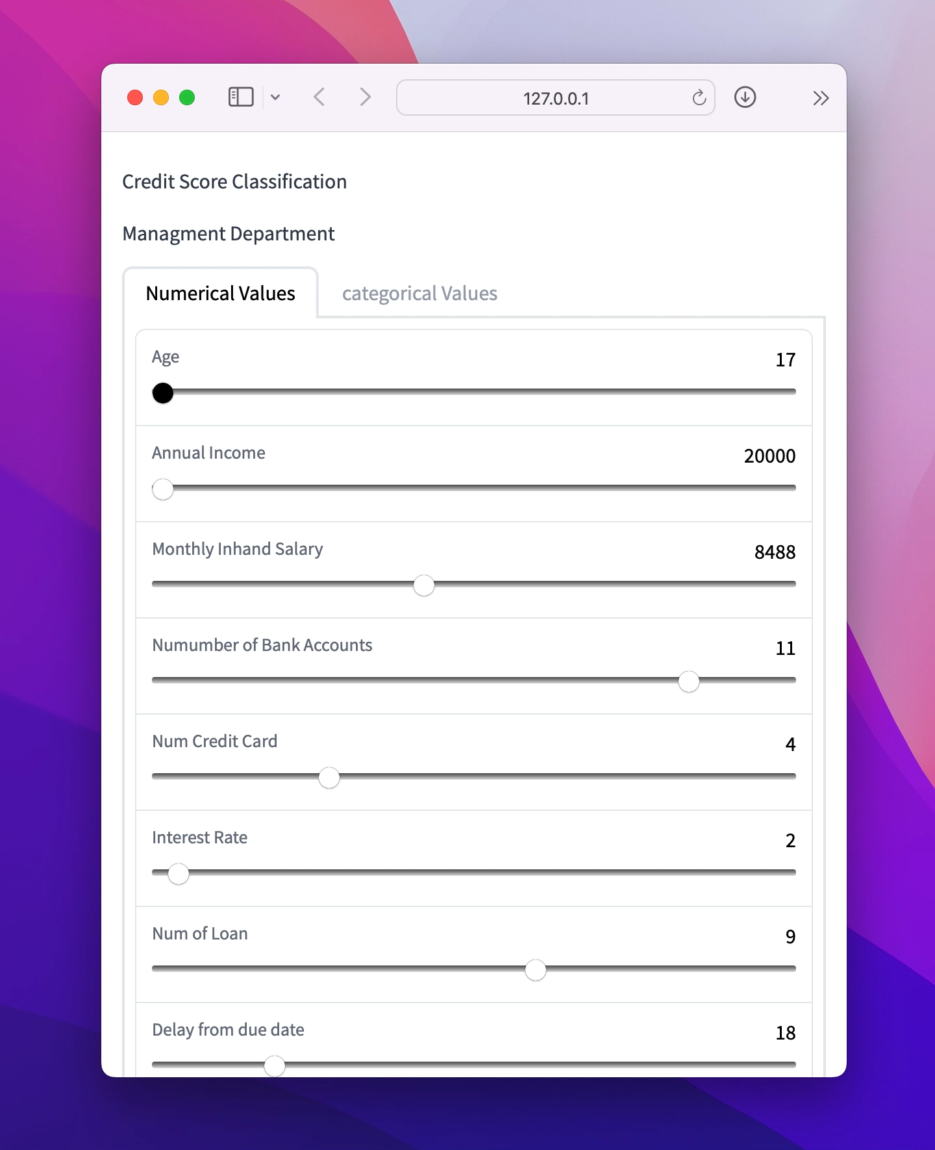
Model Deployment
We applied Gradio API as it gives a good quality user experince

Slide 17
Business Solutions
The data entry team has some serious problems, as they created some row values that are not meaningful, such as the value named “NM” in the Payment_of_Min_amount column and the “-“ value in the Credit_Mix, which will mislead other teams and affect the quality of the dataset which automatically negatively affects the model output.
The “Good” classified customers of the bank are around 17800 out of 100000 customers, which clearly indicates that the bank has a problem in its target audience, and in the marketing team.
We can also state that the marketing team needs to change its marketing campaigns and strategies to attract more “Good” and appropriate customers.
The Loan Office team also needs to reconsider its strategy of giving loans as most of the customers doesn’t pay back their loans in the specified due dates.

Slide 18
Thank You!
Omnia Elmenshawy:
LinkedIn: https://www.linkedin.com/in/omniaelmenshawy
Email: Omnia.elmenshawy22@gmail.com
Karim Akmal:
LinkedIn: https://www.linkedin.com/in/karim-akmal-296a761aa/
Email: Karim.akmal1@gmail.com

